Slide 1
The Image of the Beast
and the Great Test

Slide 2

The Great Test
"The Lord has shown me clearly that the image of the beast will be formed before probation closes; for it is to be the great test for the people of God, by which their eternal destiny will be decided.”
  Selected Messages, vol. 2, p. 80.
Notes:
READ Revelation 16:12-16
** Keeping garments = the great test DURING TIME OF GATHERING OF THE KINGS

Slide 3
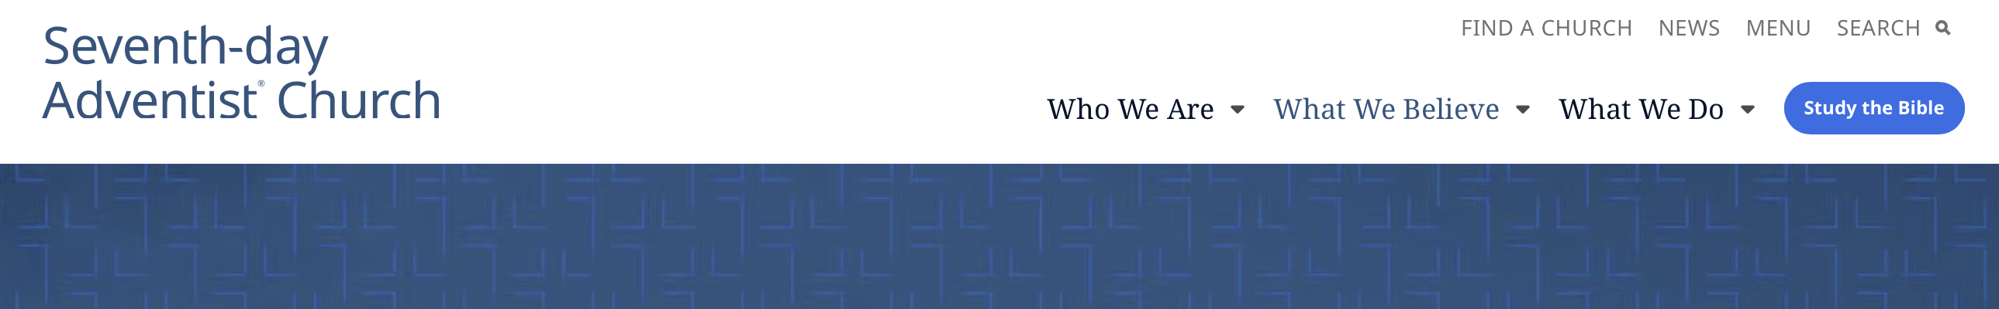
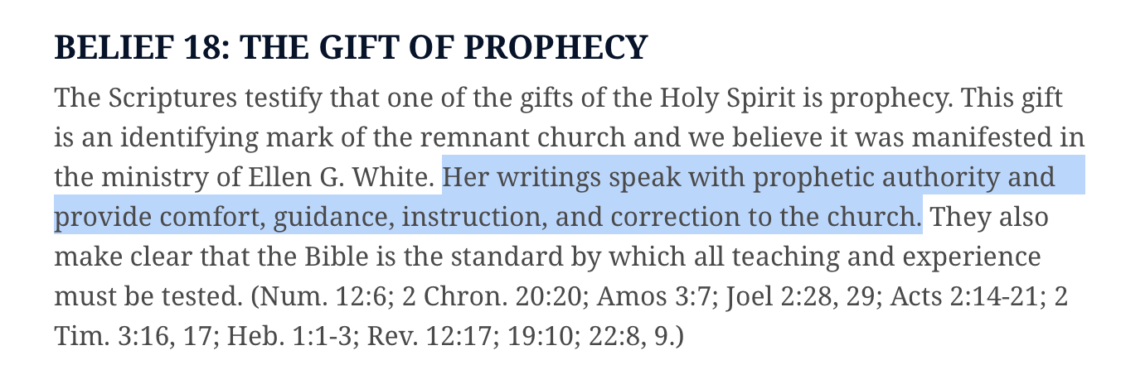
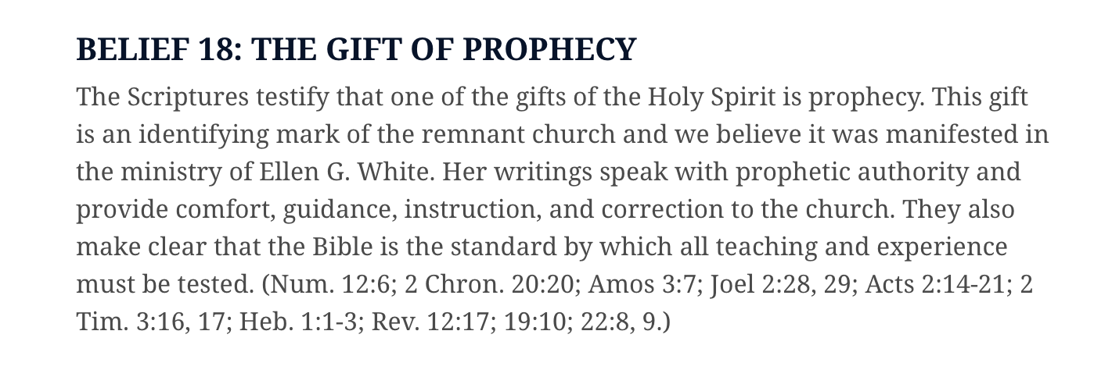
Notes:
“Authority” and “correction.”
“The very last deception of Satan will be to make of none effect the testimony of the Spirit of God. “Where there is no vision, the people perish” (Proverbs 29:18). {1SM 48}

Slide 4
The Danger for the Church
“The light we have received upon the third angel’s message is the true light. The mark of the beast is exactly what it has been proclaimed to be. Not all in regard to this matter is yet understood, nor will it be understood until the unrolling of the scroll; but a most solemn work is to be accomplished in our world.
Notes:
The mark is exactly what it has been declared to be
** the mark of the beast is the union of church and state to enforce Sunday sacredness
Not all was understood about the mark of the beast [and the image?]
** when Ellen White wrote this.
**The misunderstanding is not about the actual mark itself, because it is "exactly what it has been declared to be."
** The misunderstanding, then, must have to do with the image of the beast that leads up to the enforcement of the mark
Unrolling of the scroll connected with:
** giving of 3AM (with distinct utterance?) {Ms11-1908.9}
** the revealing of unchristlike actions {Lt69-1897.}
** liberty of conscience & freedom of speech (esp. teachers & pastors) {Ms 8a, 1888, par. 6}
** the announcement of the soon coming of Christ the King {ST June 17, 1903, par. 4}

Slide 5
The Danger for the Church
The Lord’s command to His servants is: “Cry aloud, spare not, lift up thy voice like a trumpet, and show My people their transgression, and the house of Jacob their sins.” Isaiah 58:1.
There is to be no change in the general features of our work. It is to stand as clear and distinct as prophecy has made it.
Notes:
The work of God's servants is to reveal the sins of God's people (Isaiah 58:1). The specific sin(s) to be revealed involve something that changes and mutes the general features of our work.
a confederacy with the world that many suppose will enable us to accomplish more, but that in reality changes the general features of our work and weakens the line(s) of truth that define(s) who we are.

Slide 6
The Danger for the Church
We are to enter into no confederacy with the world, supposing that by so doing we could accomplish more. If any stand in the way, to hinder the advancement of the work in the lines that God has appointed, they will displease God. No line of truth that has made the Seventh-day Adventist people what they are is to be weakened.
Notes:
Fundamental Belief #17
As the Lord's messenger, her writings are a continuing and authoritative source of truth which provide for the church comfort, guidance, instruction, and correction.

Slide 7
The Danger for the Church
We have the old landmarks of truth, experience, and duty, and we are to stand firmly in defense of our principles, in full view of the world.”
  Testimonies for the Church, vol. 6, p. 17
Notes:
Compare 400 years between Malachi (last prophetic message) and the Messiah
** the work of the Jewish nation was to prepare for the Messiah
** by accepting the image of God (compare Daniel 9:24)
Instead they, as a nation, were formed into another image
** so that when the Messiah came, His own did not receive.
** They didn’t recognize in Christ the express image of the Father.

Slide 8
No Confederacy or Alliance With the World
“The work of God is to be carried on without outward display. In establishing institutions, we are never to compete with the institutions of the world in size or splendor. We are to enter into no confederacy with those who do not love or fear God. Those who have not the light of present truth, who are unable to endure the seeing of Him who is invisible, are surrounded by spiritual darkness that is as the darkness of midnight.”
  Counsels on Health, p. 300

Slide 9
No Confederacy or Alliance With the World
“God calls to His people, saying, “Come out from among them, and be ye separate.” He asks that the love which He has shown for them may be reciprocated and revealed by willing obedience to His commandments. His children are to separate themselves from politics, from any alliance with unbelievers. They are not to link their interests with the interests of the world.

Slide 10
No Confederacy or Alliance With the World
“Now and ever we are to stand as a distinct and peculiar people, free from all worldly policy, unembarrassed by confederacy with those who have not wisdom to discern the claims of God so plainly set forth in His law.”
  Letter 110, 1902. {MM 329.1}

Slide 11
No Confederacy or Alliance With the World
“Every device that the prince of darkness can suggest will be employed to induce God’s servants to form a confederacy with the agents of Satan. Repeated solicitations will come to call them from duty; but, like Nehemiah, they should steadfastly reply, “I am doing a great work, so that I cannot come down.”
  Prophets and Kings, p. 659

Slide 12
No Confederacy or Alliance With the World
…True Christian influence, exerted for the accomplishment of the work God has appointed, is a precious agency, and it must not be united with politics, or bound up in a confederacy with unbelievers. God is to be the center of attraction. Every mind that is worked by the Holy Spirit will be satisfied with Him.”
  Fundamentals of Education, p. 483

Slide 13
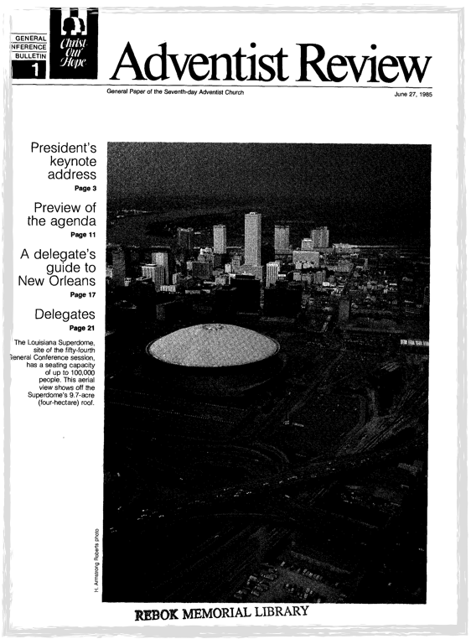

The SDA Church and the UN
“On May 10 the United Nations recognized the General Conference of Seventh-day Adventists as a nongovernmental organization (NGO) in consultative status with the Economic and Social Council of the United Nations.”
  Adventist Review, June 27, 1985, p. 7
Notes:
Application for NGO status approved on May 10, 1985.
** Announced at GC session in 1985 without vote
** Review article with transcript of speech by GC president
Member of ECOSOC (Economic and Social Counsel)

Slide 14

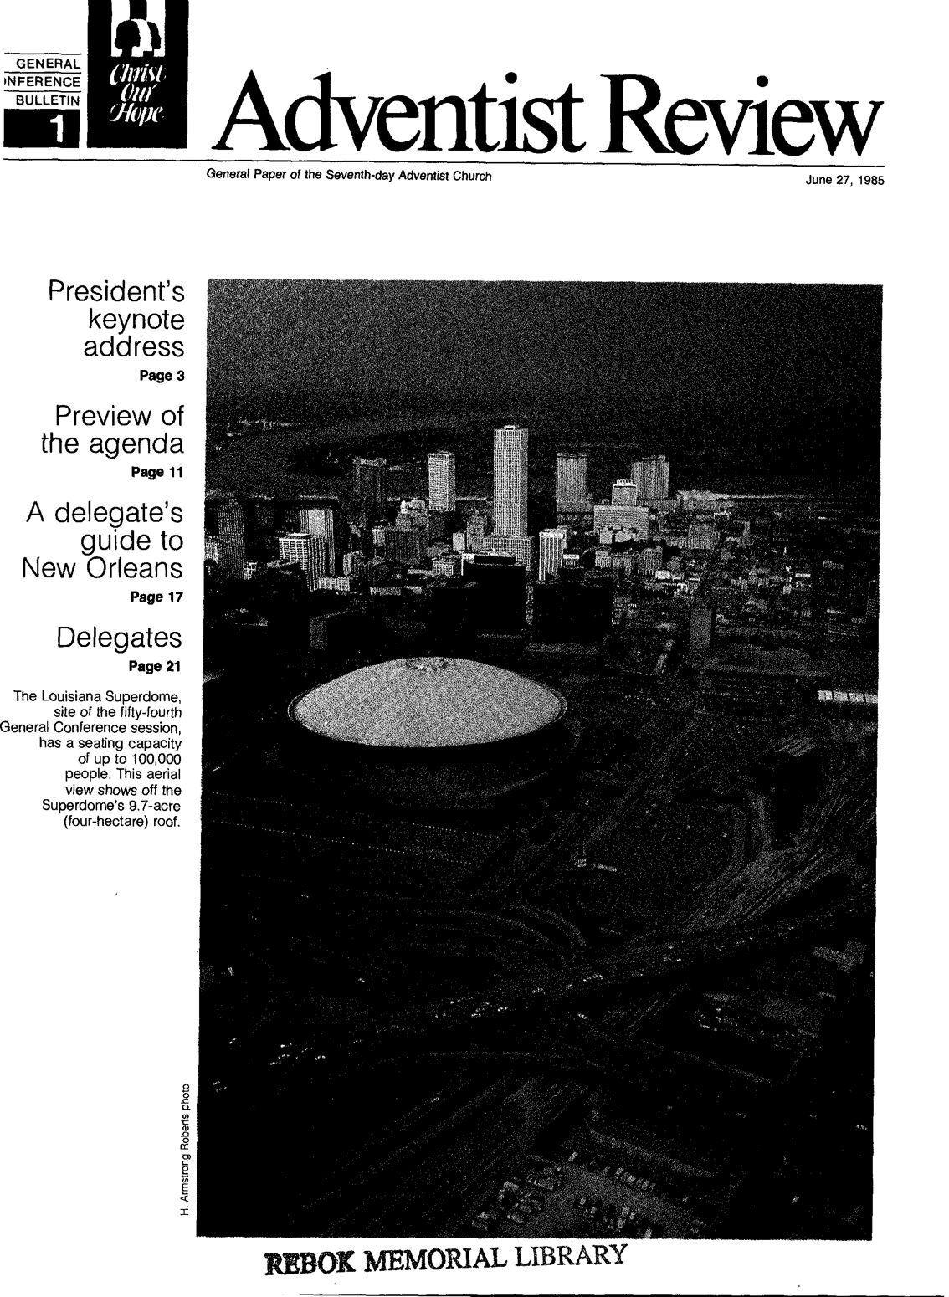
The SDA Church and the UN
“We believe that the new status [as a United Nations NGO] will provide the Seventh-day Adventist Church with another opportunity to establish a presence and exert a positive Christian outreach among civic, religious, and government leaders of all the nations of the world.”
  Adventist Review, June 27, 1985, p. 7
Notes:
Application for NGO status approved on May 10, 1985.
** Announced at GC session in 1985 without vote
** Review article with transcript of speech by GC president
Member of ECOSOC (Economic and Social Counsel)

Slide 15
SDA Mission Statements
1985 UN NGO Application
"The mission statement of the Seventh-day Adventist Church is to call all people to become disciples of Jesus Christ, to proclaim the everlasting gospel embraced by the three angels' messages (Rev. 14:6-12), and to prepare the world for Christs's soon return.”
1990-1993 Quadrennial Report
"The mission of the church is to proclaim to all people the everlasting gospel as described in the Holy Bible.”

Slide 16
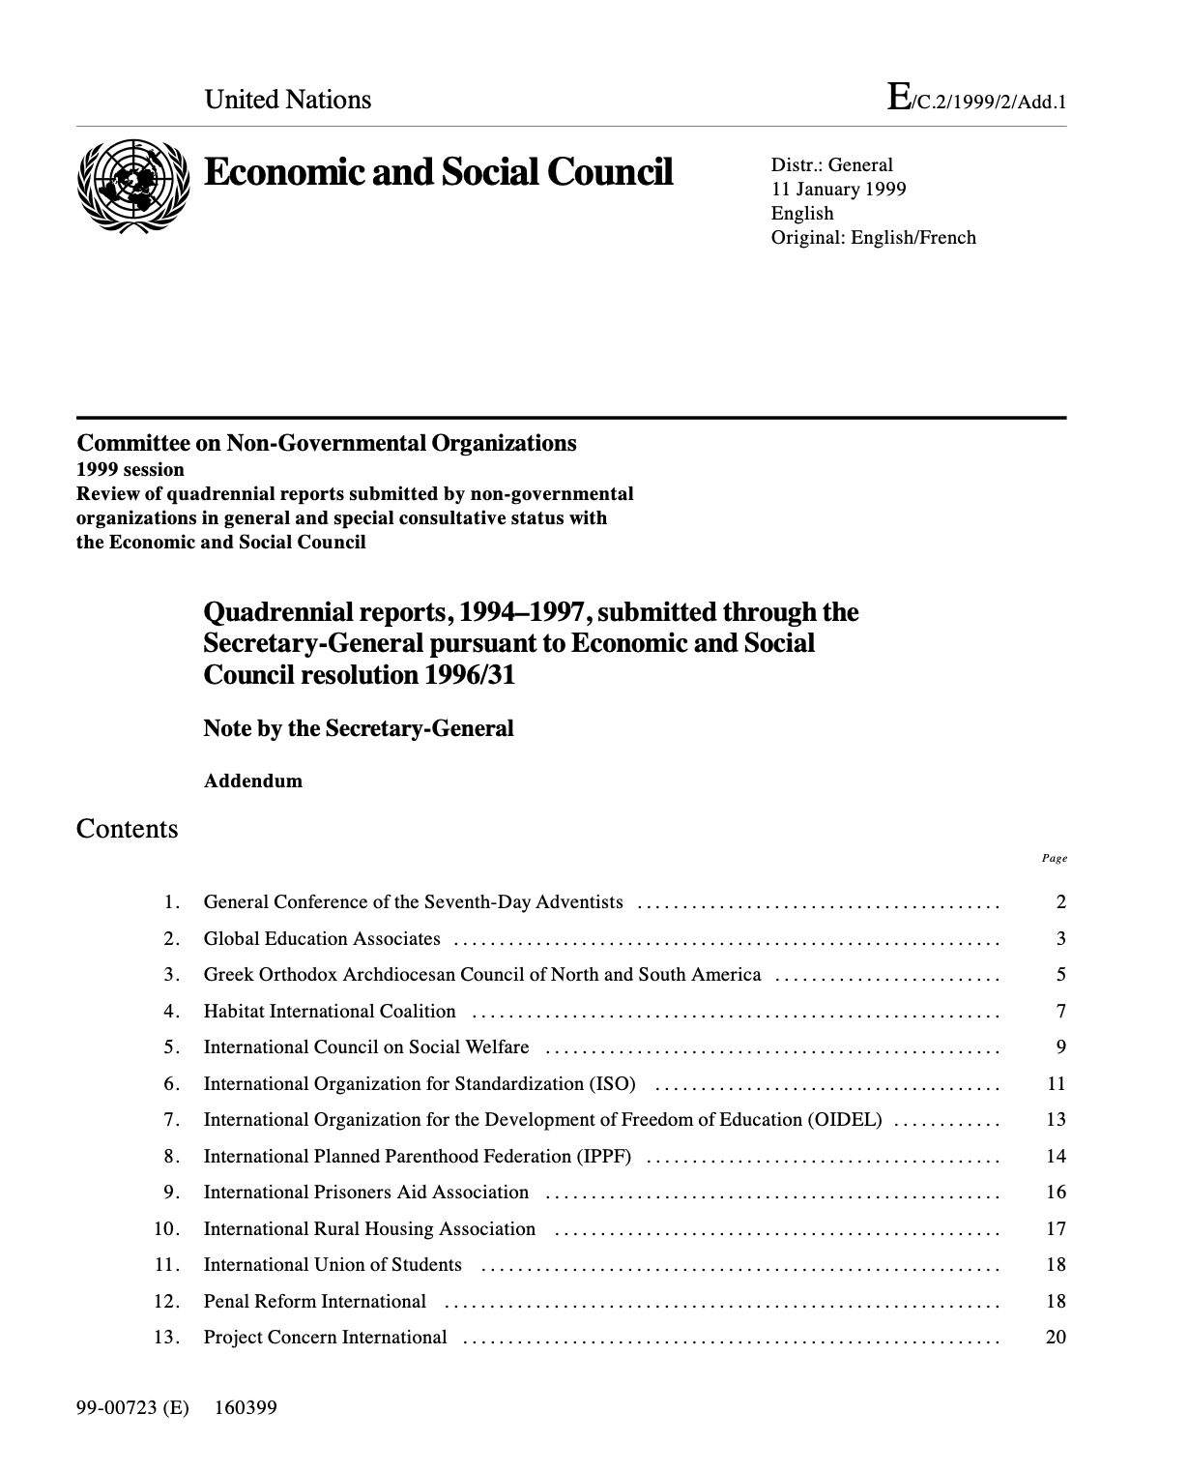
SDA Mission Statements
1994-1997 Quadrennial Report
"The Seventh-Day Adventist Church seeks to lead people to a saving relationship with Jesus Christ and to enhance the quality of life not only for its members but for people in all nations of the world."

Slide 17
SDA Mission Statements
2005-2008 Quadrennial Report
"The General Conference of Seventh-day Adventists (GCSA) is the world governing body of the Seventh-day Adventist Church, a Christian organization that promotes a better life, both spiritual and physical, for individuals and communities.
…The values and principles of the Adventist Church find expression in a wide variety of activities that parallel United Nations goals, including health, education, humanitarian aid, youth training, women’s issues, child development, religious freedom and human rights promotion.”

Slide 18
SDA Mission Statements
2009-2012 Quadrennial Report
“The General Conference of Seventh Day Adventists actively affirms, develops and educates on the principles of religious liberty and freedom of conscience enshrined in the United Nations documents dealing with religious freedom. These include but are not limited to article 18 of the Universal Declaration of Human Rights, article 18 of the International Covenant on Civil and Political Rights, and the Declaration on the Elimination of All Forms of Intolerance and of Discrimination Based on Religion or Belief.”

Slide 19
Prophets and Kings, p. 53, 54
“Satan knew the results that would attend obedience; and during the earlier years of Solomon’s reign—years glorious because of the wisdom, the beneficence, and the uprightness of the king—he sought to bring in influences that would insidiously undermine Solomon’s loyalty to principle and cause him to separate from God. That the enemy was successful in this effort, we know from the record: “Solomon made affinity with Pharaoh king of Egypt, and took Pharaoh’s daughter, and brought her into the City of David.” 1 Kings 3:1.

Slide 20
Prophets and Kings, p. 53, 54
From a human point of view, this marriage, though contrary to the teachings of God’s law, seemed to prove a blessing; for Solomon’s heathen wife was converted and united with him in the worship of the true God. Furthermore, Pharaoh rendered signal service to Israel by taking Gezer, slaying “the Canaanites that dwelt in the city,” and giving it “for a present unto his daughter, Solomon’s wife.” 1 Kings 9:16. This city Solomon rebuilt and thus apparently greatly strengthened his kingdom along the Mediterranean seacoast.”

Slide 21

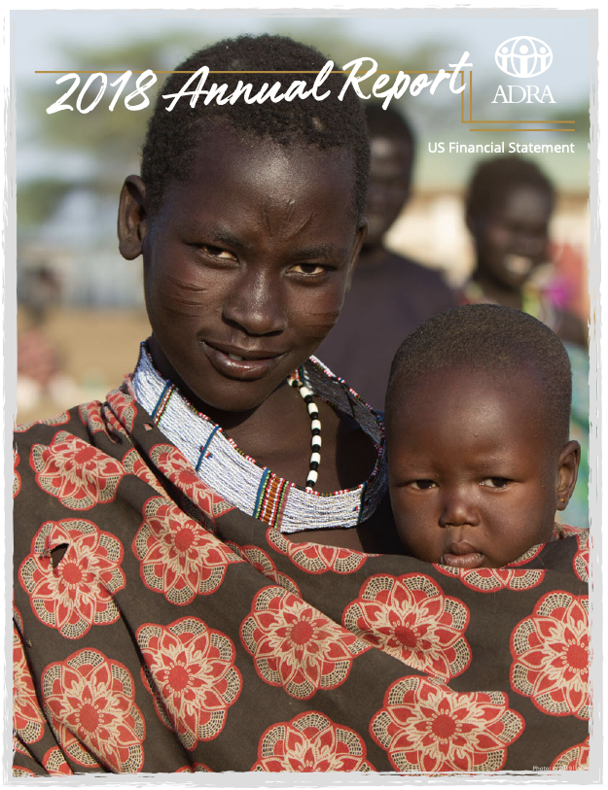
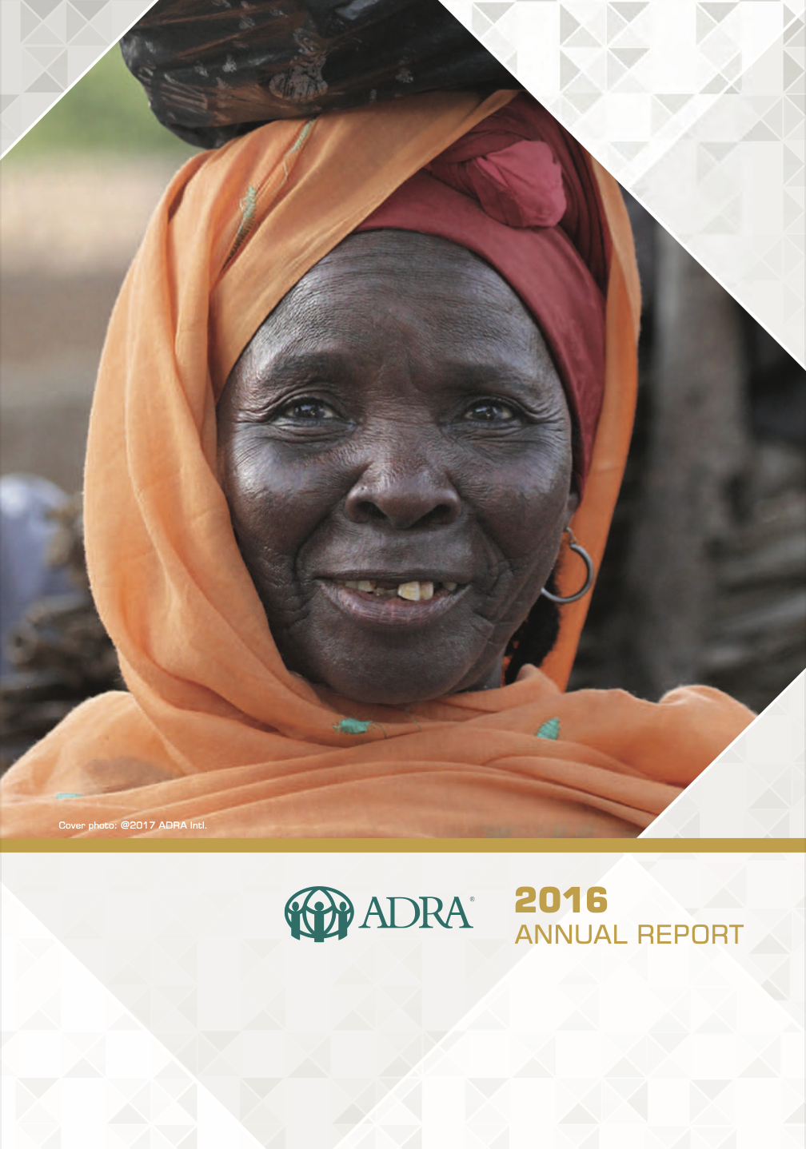

According to its annual reports, ADRA received $105,534,079.00 in funding and $82,811,671.00 in commodities from the United Nations in 2016-2018.

Slide 22
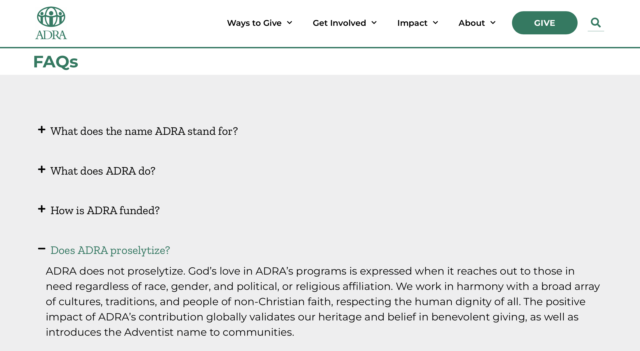

Slide 23
Prophets and Kings, p. 53, 54
“But in forming an alliance with a heathen nation, and sealing the compact by marriage with an idolatrous princess, Solomon rashly disregarded the wise provision that God had made for maintaining the purity of His people. The hope that his Egyptian wife might be converted was but a feeble excuse for the sin.”

Slide 24
Prophets and Kings, p. 53, 54
“For a time God in His compassionate mercy overruled this terrible mistake; and the king, by a wise course, could have checked at least in a large measure the evil forces that his imprudence had set in operation. But Solomon had begun to lose sight of the Source of his power and glory. As inclination gained the ascendancy over reason, self-confidence increased, and he sought to carry out the Lord’s purpose in his own way.”

Slide 25

ECOSOC Resolution 1296 (May 23, 1968)
“2. The aims and purposes of the organization shall be in conformity with the spirit, purposes and principles of the Charter of the United Nations.
3. The organization shall undertake to support the work of the United Nations and to promote knowledge of its principles and activities, in accordance with its own aims and purposes and the nature and scope of its competence and activities.”
Notes:
Economic and Social Counsel

Slide 26
UN DPI (Department of Information)
NGOs associated with DPI disseminate information about the UN to their membership, thereby building knowledge of and support for the Organization at the grassroots level. This dissemination includes:
Publicizing UN activities around the world on such issues as peace and security, economic and social development, human rights, humanitarian affairs and international law;
Promoting UN observances and international years established by the General Assembly to focus world attention on important issues facing humanity.
  https://www.un.org/esa/coordination/ngo/dpi.htm

Slide 27
Official Statements
Tolerance (1995) | Support of United Nations 1995 Year of Tolerance.
Religious Freedom (1995) | Support of religious freedom in harmony with instruments of United Nations.
Smoking and Ethics (October 1, 1996) | World Health Assembly votes “International framework convention for tobacco control” (May 25, 1996)
Family Violence (October 1, 1996) | UN Resolution 50/166 eliminating violence against women (February 16, 1996).
Notes:
“United Nations” 12 times
“Spirit of Prophecy” 1 time
Ellen G White 13 times

Slide 28
Official Statements
Child Sexual Abuse (April 1, 1997) | Report of the Special Rapporteur on the sale of children, child prostitution and child pornography (February 17, 1997).
Academic Freedom (October 11, 1997) | UNESCO adopts Recommendation concerning the Status of Higher-Education Teaching Personnel (November 11, 1997).
Ethical Consideration Concerning Human Cloning (September 27, 1998) | UNESCO creates Universal Declaration on the Human Genome and Human Rights (November 11, 1997).
50th Anniversary of the Declaration of Human Rights (November 17, 1998) | Describes the UDHR as “coming from the best and highest part of the human heart.”

Slide 29
Official Statements
Religious Minorities and Religious Freedom (September 29, 1999) | Supports Article 18 of the UDHR
Well-Being and Value of Children (June 29, 2000) | Refers to UN “Convention on the Rights of the Child” (1989)
Religious Liberty, Evangelism, and Proselytism (June 29, 2000) | UN Millennium Peace Summit of Religious and Spiritual Leaders (August 2000)
War in Congo (December 2, 2008). Statement distanced the church from opposition leader. | Peace talks begin between UN-backed Congolese government and opposition (December 9, 2008).

Slide 30
Official Statements
Commitment to Health and Healing (October 14, 2009) | "This statement follows the deliberations and recommendations of the Global Conference on Health and Lifestyle held in Geneva July 2009 in collaboration with the World Health Organization, and calls for cooperation with similar credible bodies aiming to improve global health."
Global Poverty (June 23, 2010) | "UN identifies strategies to accelerate development and poverty reduction “ (June 17, 2010)

Slide 31
Official Statements
Freedom of Speech and Defamation of Religion (June 23, 2010) | Supports freedom of speech in harmony with UDHR Article 19.
Ending Violence Against Women and Girls (June 23, 2010) | United Nations Human Rights Council adopted a resolution, "Accelerating efforts to eliminate all forms of violence against women : ensuring due diligence in prevention” (June 18, 2010)

Slide 32
Official Statements
One Humanity (September 15, 2020) | During September 2020, the United Nations (UN) and its subsidiary bodies frequently invoked the theme of "one humanity," particularly in the context of the COVID-19 pandemic and the UN's 75th anniversary.
Immunization Reaffirmation Statement (October 6, 2021) | “Therefore, claims of religious liberty are not used appropriately in objecting to government mandates or employer programs designed to protect the health and safety of their communities.”

Slide 33
Prophets and Kings, p. 53, 54
“[Solomon] reasoned that political and commercial alliances with the surrounding nations would bring these nations to a knowledge of the true God; and he entered into unholy alliance with nation after nation. Often these alliances were sealed by marriages with heathen princesses. The commands of Jehovah were set aside for the customs of surrounding peoples.”

Slide 34
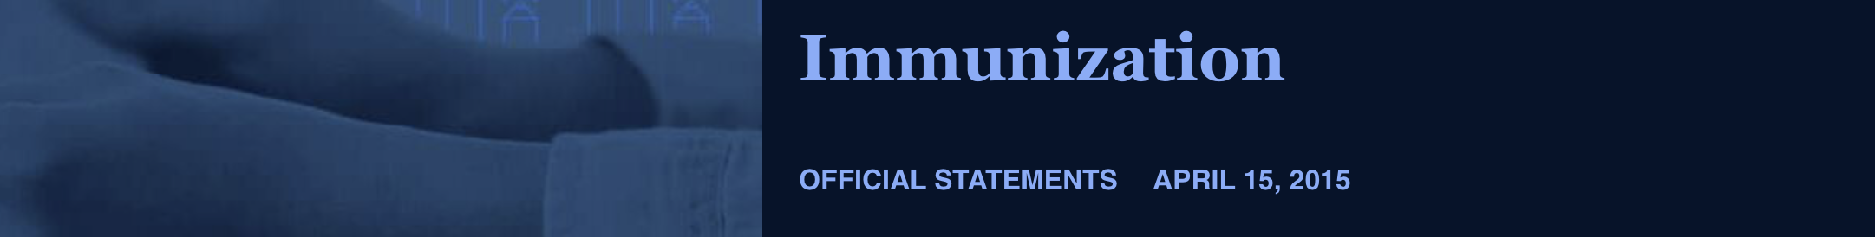
The Health Statements
The Seventh-day Adventist Church places strong emphasis on health and well-being. The Adventist health emphasis is based on the Bible, the inspired writings of Church co-founder Ellen G White, and is informed by peer-reviewed scientific health literature. As such, we encourage responsible immunization/vaccination, and have no religious or faith-based reason not to encourage our adherents to responsibly participate in protective and preventive immunization programs. We value the health and safety of the population, which includes the maintenance of what is known as “herd immunity.”

Slide 35
The Health Statements
We are not the conscience of the individual church member, and we recognize individual choices. These choices are exercised by the individual. Refusal of immunization is not and should not be seen as a teaching nor a doctrine of the Seventh-day Adventist Church.
This statement was voted by the General Conference of Seventh-day Adventists Administrative Committee in Silver Spring, Maryland, April 15, 2015.
https://gc.adventist.org/official-statements/immunization/

Slide 36
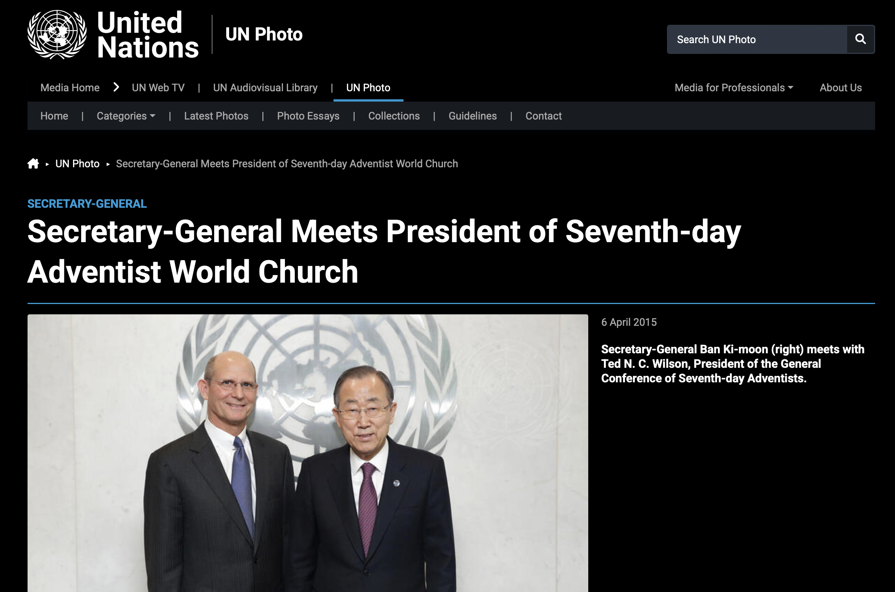
Notes:
April 6, 2015. Nine days before the immunization statement was released (April 15).

Slide 37
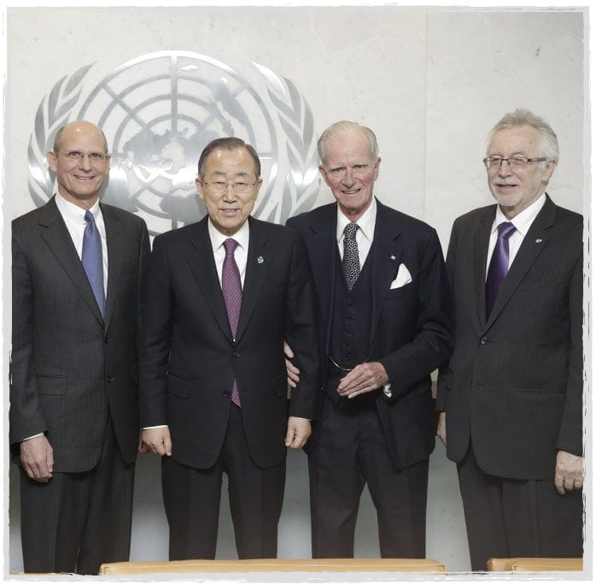
A Historic Meeting
“United Nations Secretary-General Ban Ki-moon expressed concerns about growing religious intolerance worldwide during a private meeting with Adventist Church leader Ted N.C. Wilson, and he invited the Seventh-day Adventist Church to work with the UN in helping people.
Notes:
Meeting on April 6

Slide 38
A Historic Meeting
…the first Adventist Church president to meet with a UN chief, noted that the church has long supported religious liberty and said it was willing to team up on initiatives that followed Christ’s ministry of helping people physically, mentally, socially, and spiritually.”
  Adventist Review, April 7, 2015
Notes:
Meeting on April 6

Slide 39

“World Immunization Week 2015 will signal a renewed global, regional, and national effort to accelerate action to increase awareness and demand for immunization by communities, and improve vaccination delivery services.”
  WHO (24-30 April 2015)

Slide 40
A Historic Meeting
“‘The impressive portfolio that the Seventh-day Adventist Church has developed for service to the whole human family remarkably resonates with the Millennium Development Goals and the Sustainable Development Goals of the UN,’ [the religious liberty leader] said in a statement.”
  Adventist Review, April 7, 2015

Slide 41
Prophets and Kings, p. 53, 54
“Solomon flattered himself that his wisdom and the power of his example would lead his wives from idolatry to the worship of the true God, and also that the alliances thus formed would draw the nations round about into close touch with Israel. Vain hope! Solomon’s mistake in regarding himself as strong enough to resist the influence of heathen associates was fatal. And fatal, too, the deception that led him to hope that notwithstanding a disregard of God’s law on his part, others might be led to revere and obey its sacred precepts.”

Slide 42
No Justice for God’s People
“While men are sleeping, Satan is actively arranging matters so that the Lord’s people may not have mercy or justice. The Sunday movement is now making its way in darkness. The leaders are concealing the true issue, and many who unite in the movement do not themselves see whither the undercurrent is tending. Its professions are mild and apparently Christian, but when it shall speak it will reveal the spirit of the dragon.”
  Counsels to the Church, p. 335

Slide 43
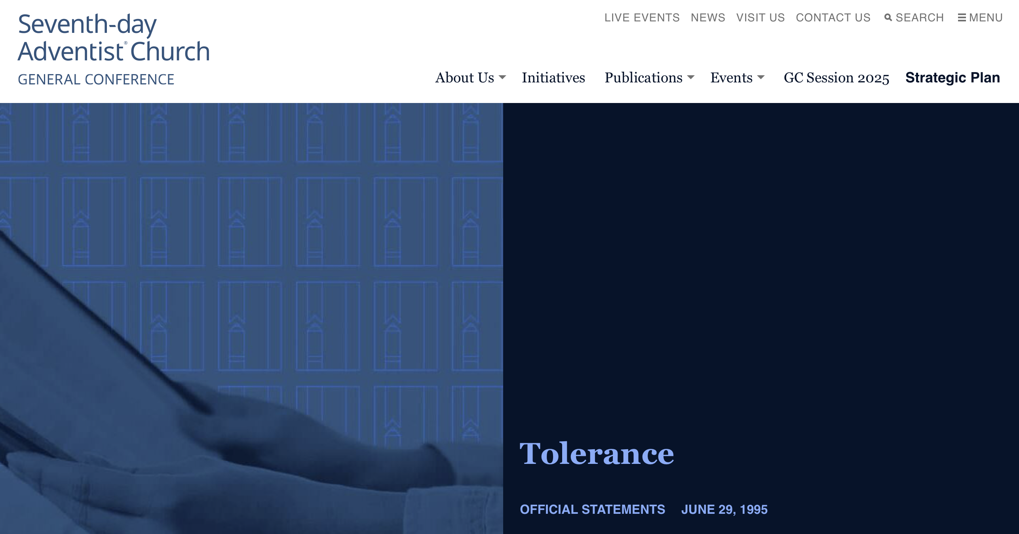
“Seventh-day Adventists support the United Nations proclamation of 1995 as the Year of Tolerance. This proclamation comes at an opportune time when intolerance is abounding on all continents–bigoted religious extremism, racism, tribalism, ethnic cleansing, linguistic enmity, and other forms of terrorism and violence. Christians carry their share of the blame for prejudice and inhumanity toward humans.”
Notes:
UNESCO Declaration of Principles on Tolerance: (https://www.ohchr.org/en/resources/educators/human-rights-education-training/13-declaration-principles-tolerance-1995)
Reference to "Declaration on the Elimination of All Forms of Intolerance Based on Religion or Belief" (https://www.ohchr.org/en/instruments-mechanisms/instruments/declaration-elimination-all-forms-intolerance-and-discrimination

Slide 44
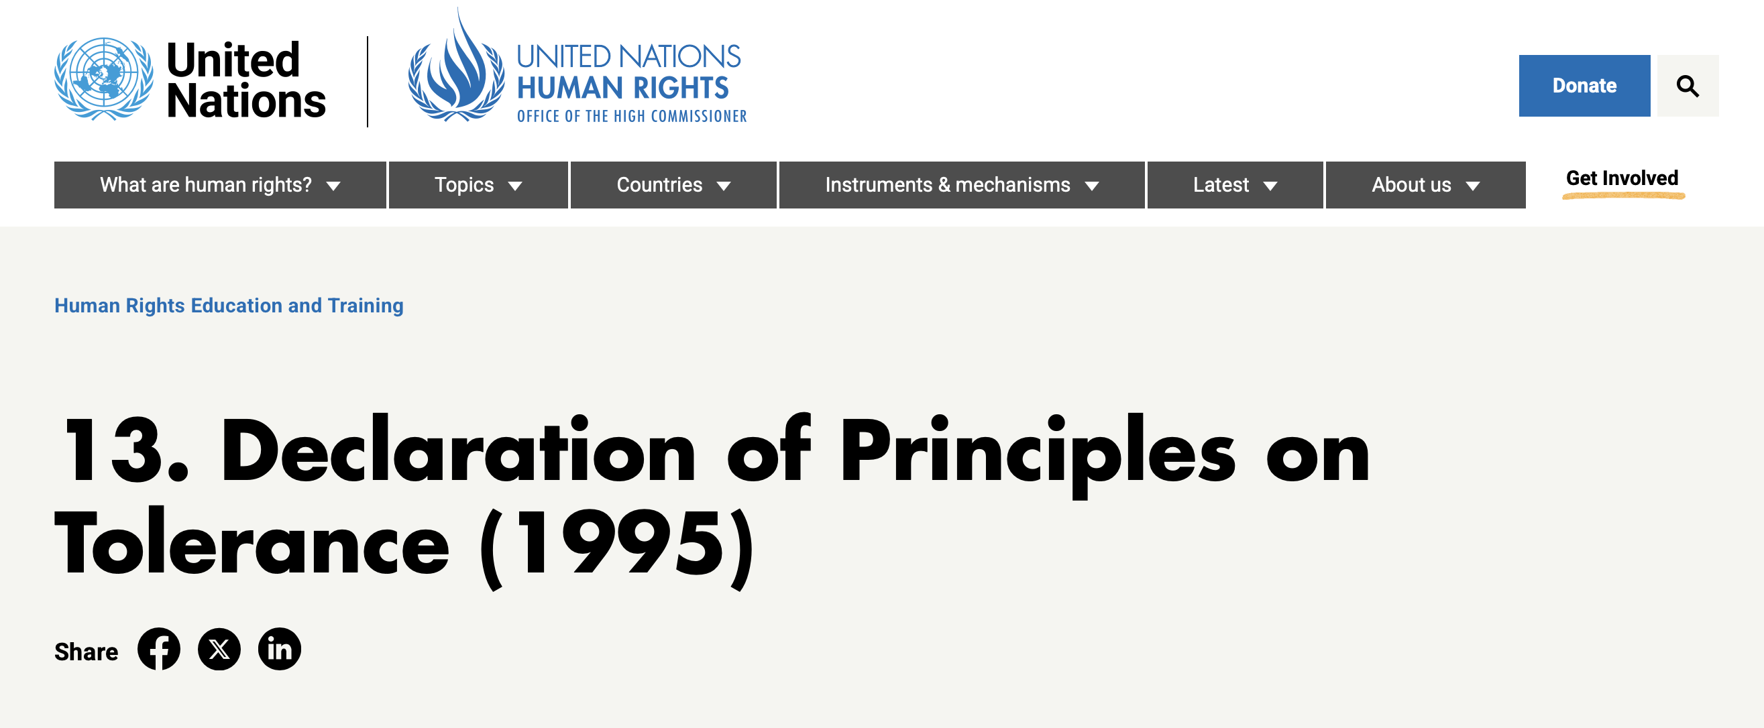
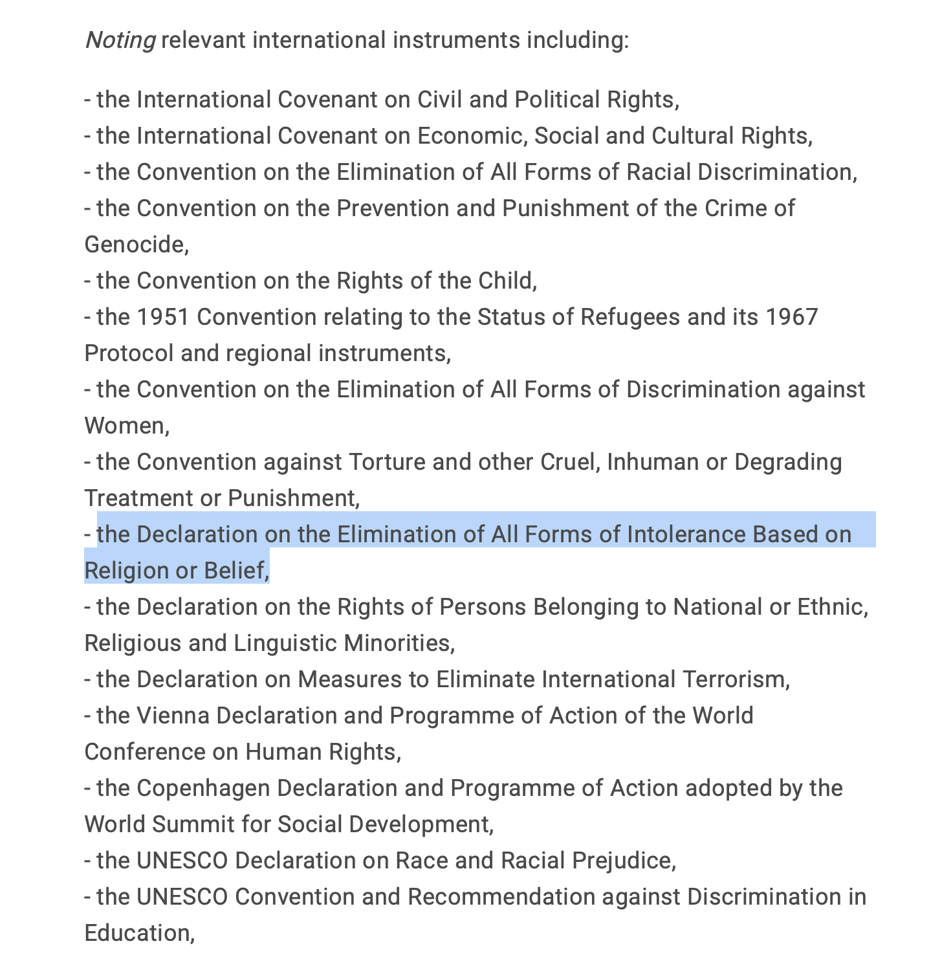
Notes:
The Declaration on the Elimination of All Forms of Intolerance Based on Religion or Belief

Slide 45
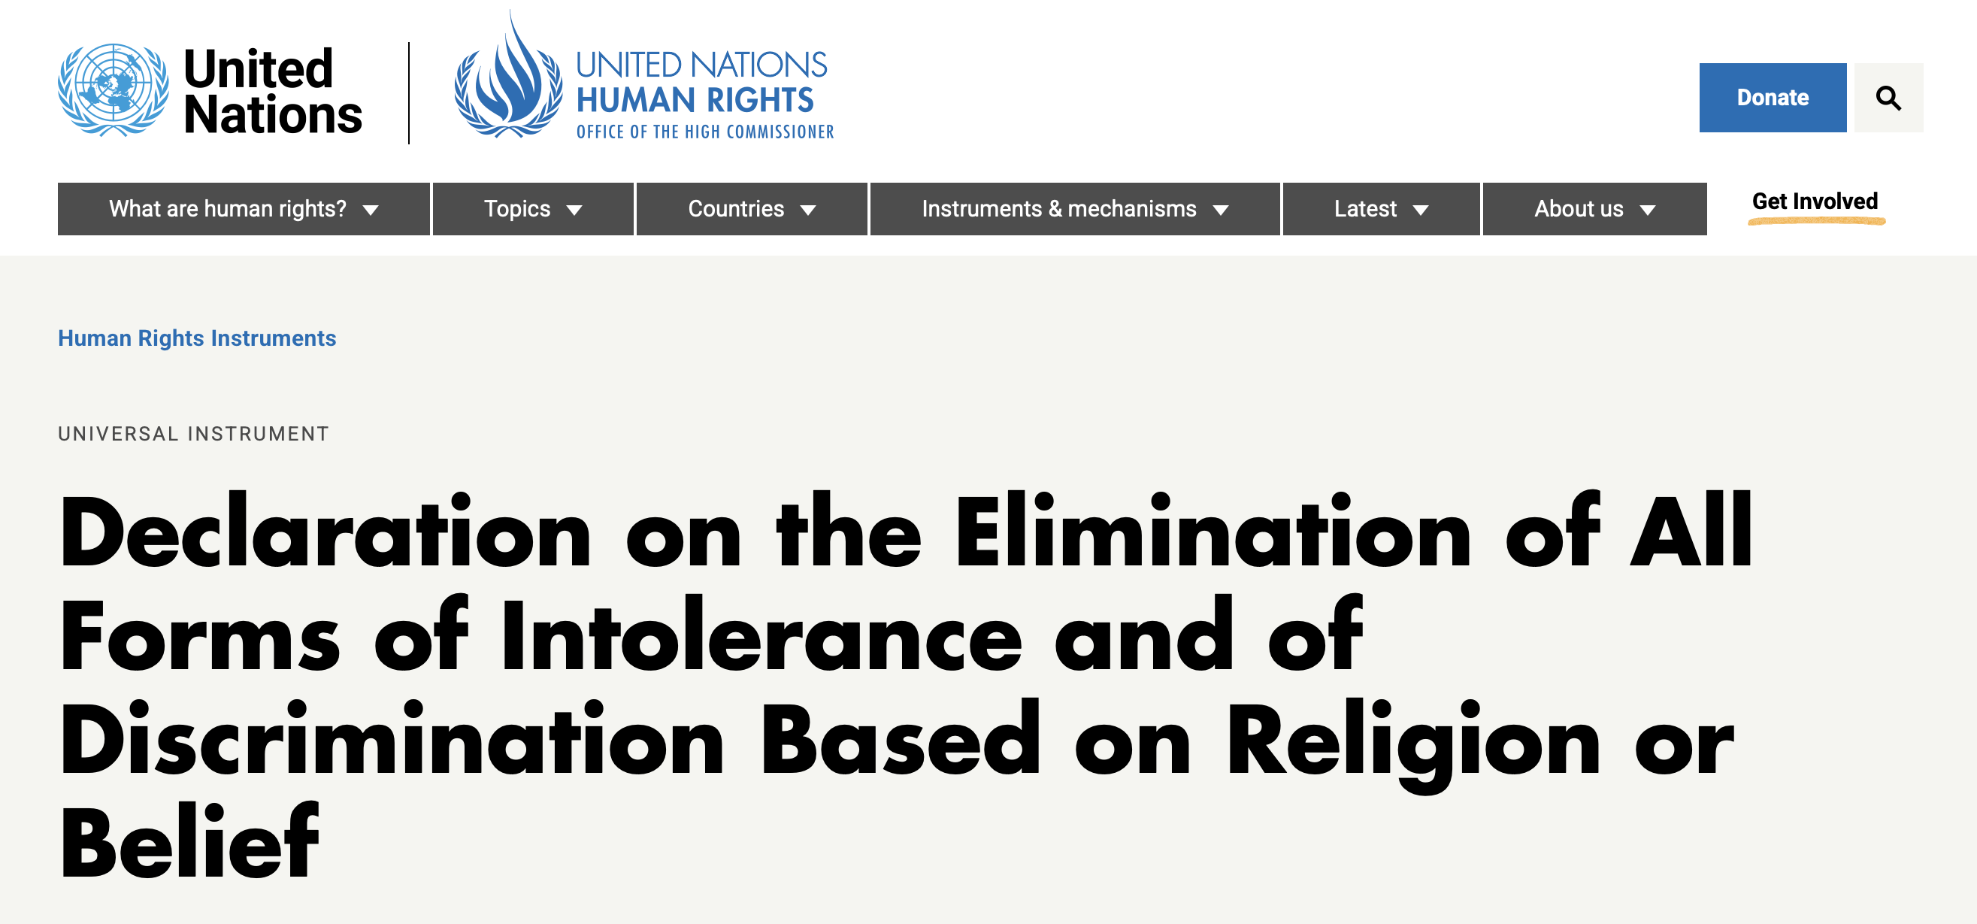
Preamble: "Considering that it is essential to promote understanding, tolerance and respect in matters relating to freedom of religion or belief and to ensure that the use of religion or belief for ends inconsistent with the Charter, other relevant instruments of the United Nations and the purposes and principles of the present Declaration is inadmissible,
  https://www.ohchr.org/en/instruments-mechanisms/instruments/declaration-elimination-all-forms-intolerance-and-discrimination

Slide 46
Article 1.3. “Freedom to manifest one's religion or belief may be subject only to such limitations as are prescribed by law and are necessary to protect public safety, order, health or morals or the fundamental rights and freedoms of others.”
  https://www.ohchr.org/en/instruments-mechanisms/instruments/declaration-elimination-all-forms-intolerance-and-discrimination

Slide 47
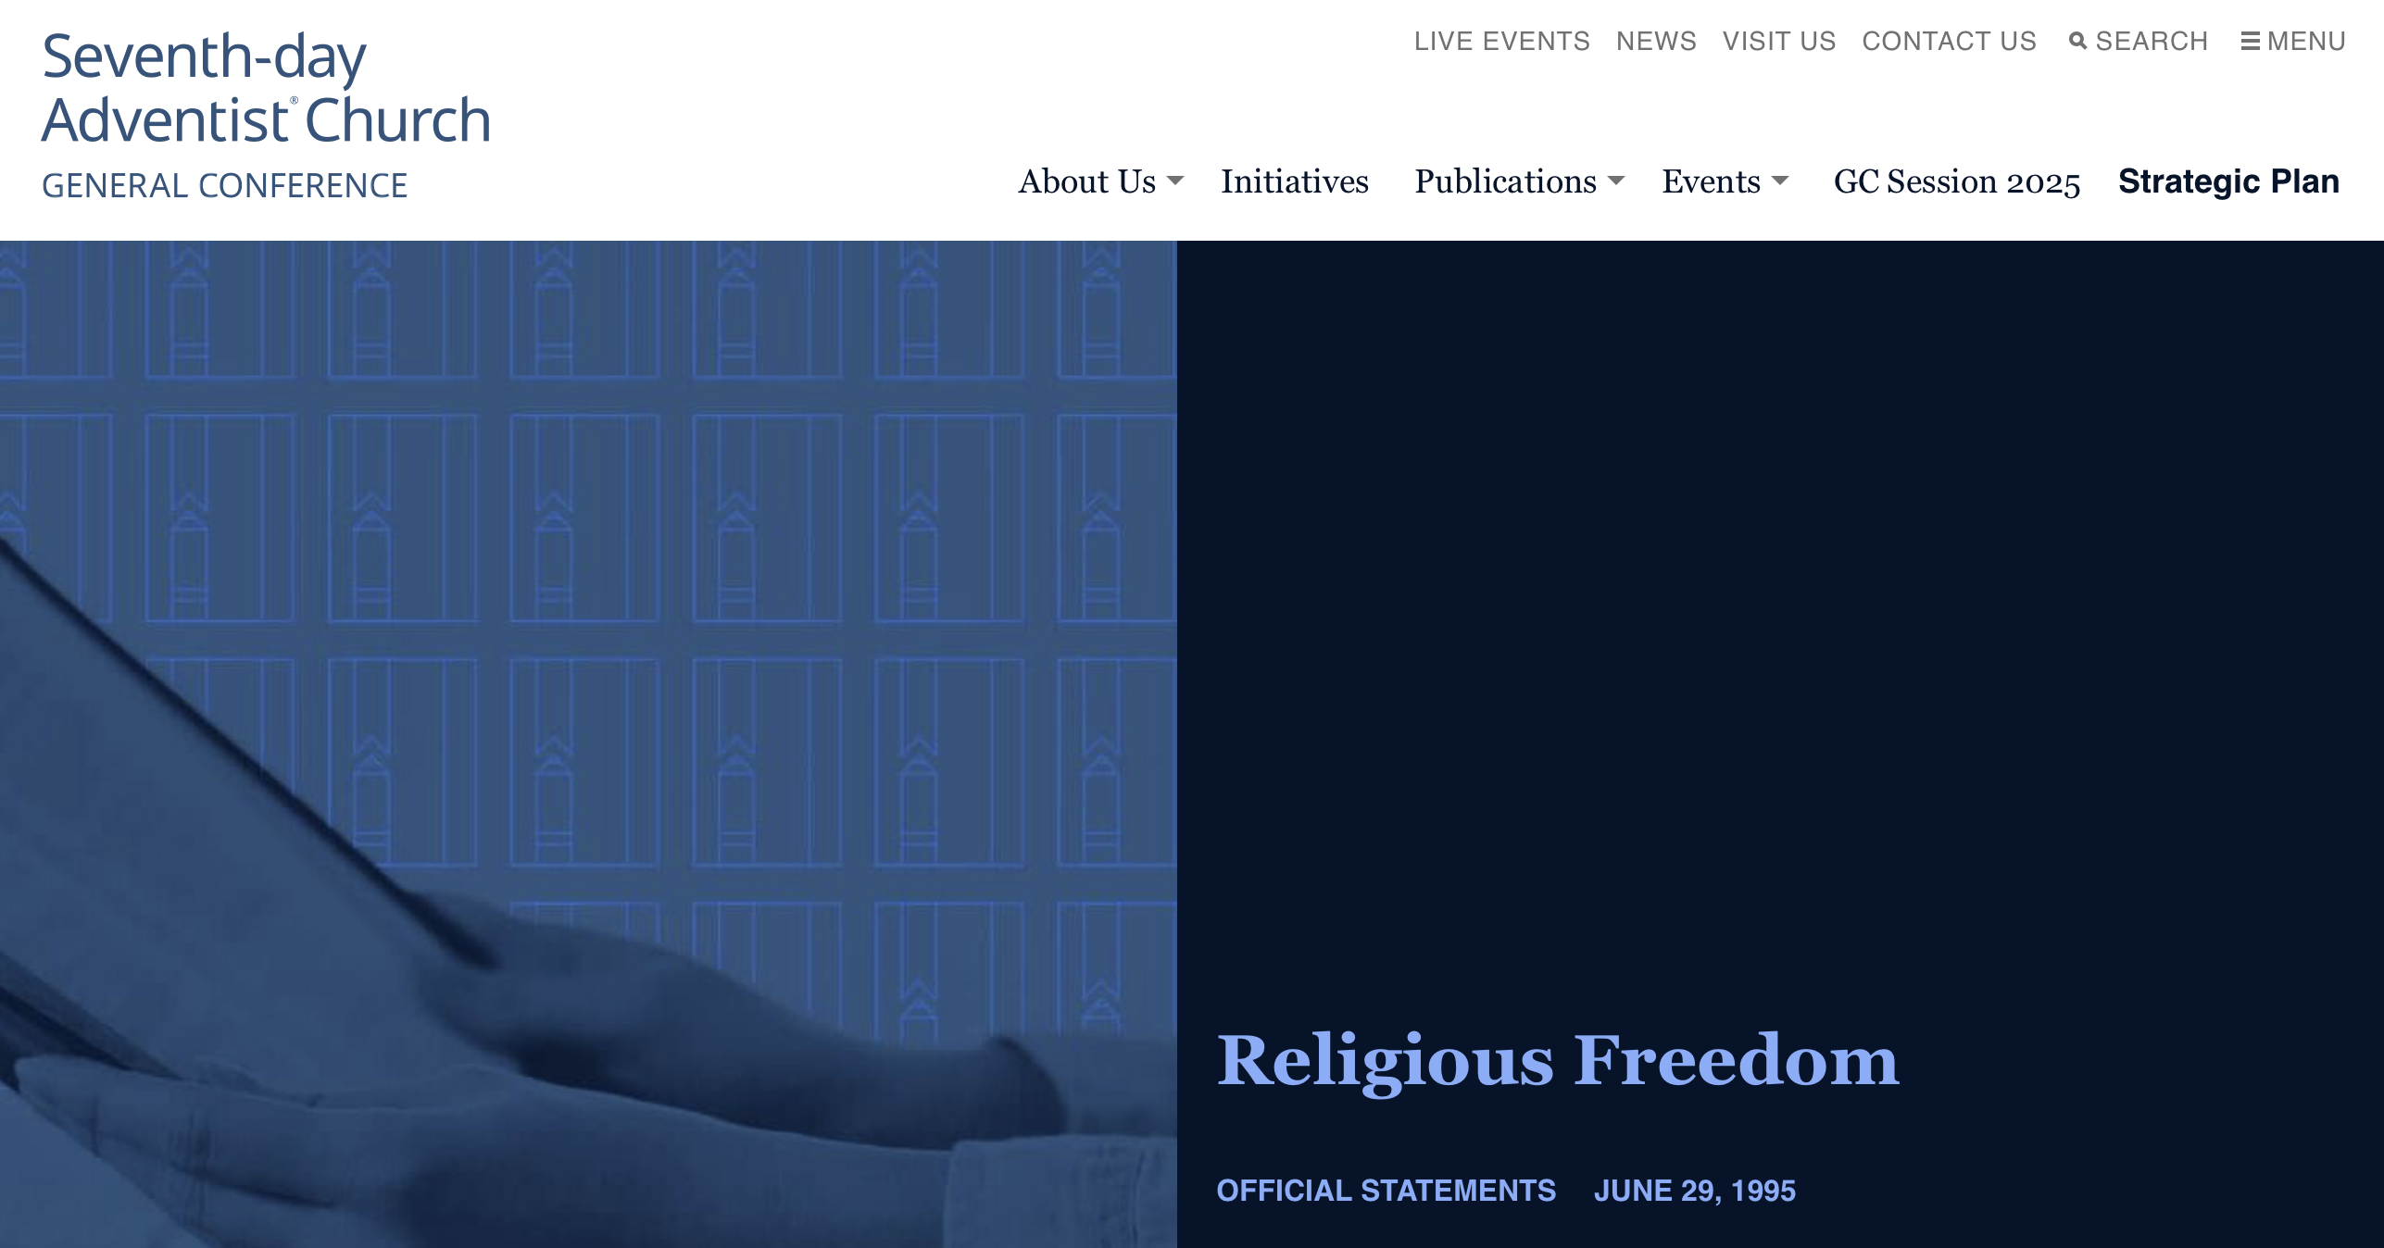
“For more than a century Seventh-day Adventists have been active promoters of religious freedom. We recognize the need to champion freedom of conscience and religion as a fundamental human right, in harmony with the instruments of the United Nations.
…As loyal citizens, Adventists believe they have the right to freedom of religion, subject to the equal rights of others.”

Slide 48
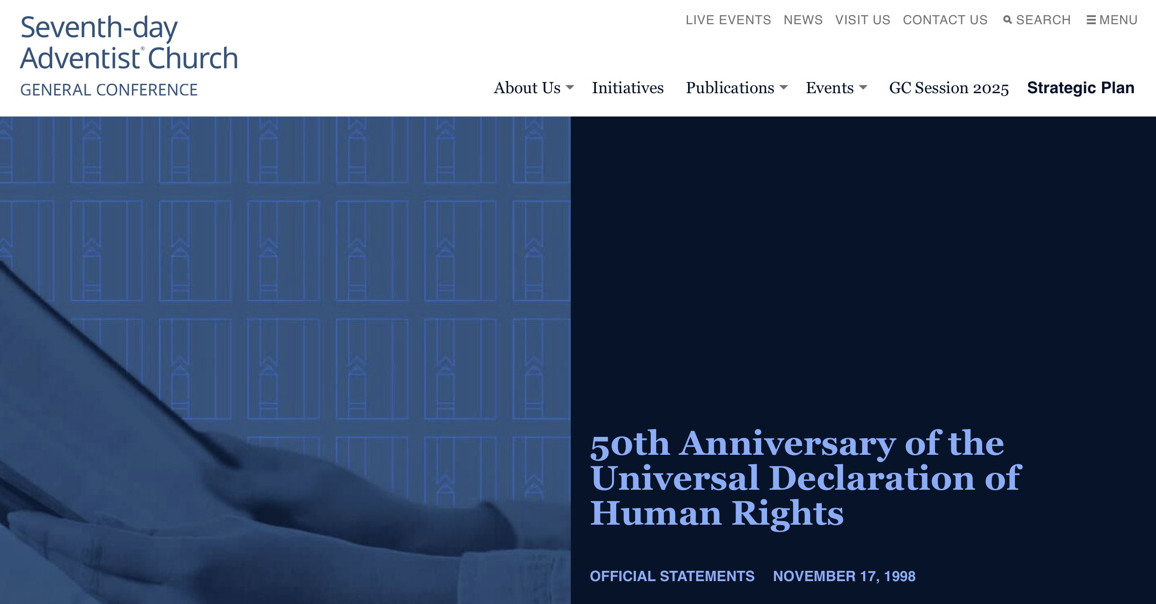
“The 1948 Universal Declaration of Human Rights was written and adopted by individuals who had emerged from the unprecedented destruction, disorientation and distress of World War II. This harrowing experience gave them a vision of and desire for a future world of peace and freedom. Coming from the best and highest part of the human heart, the Universal Declaration is a fundamental document standing firmly for human dignity, liberty, equality, and non-discrimination of minorities.”

Slide 49
“The Seventh-day Adventist Church urges the United Nations, government authorities, religious leaders and believers, and non-government organizations to consistently work for the implementation of this Declaration. …In this way, the Universal Declaration will grow in practical importance and luster, and never risk becoming an irrelevant document.”

Slide 50
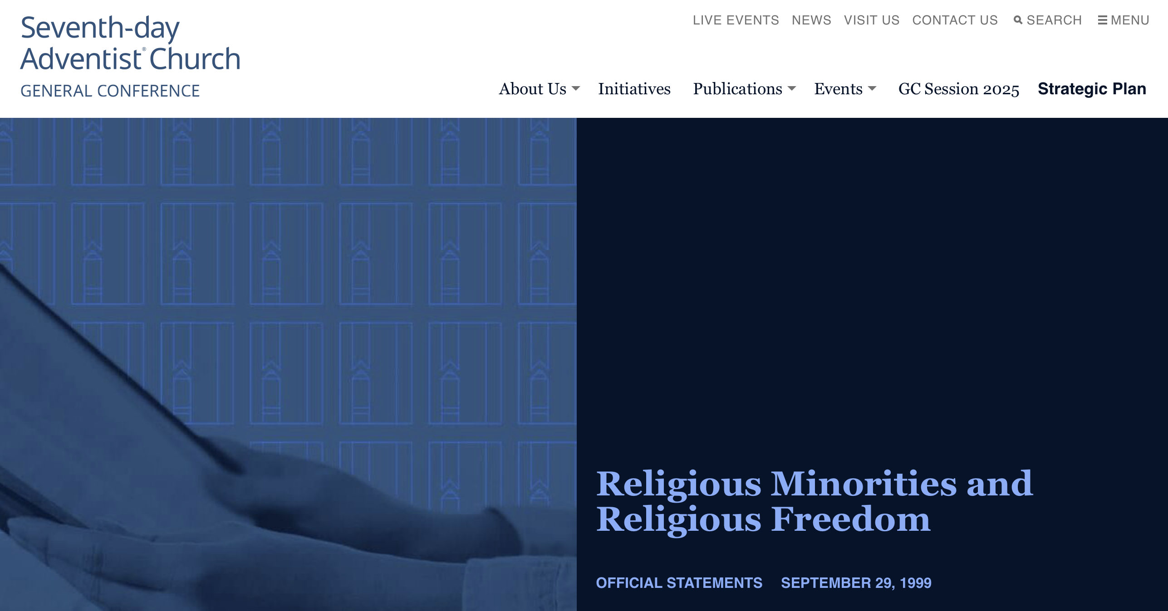
“Throughout history religious minorities have often been subject to discrimination and outright persecution. Today religious intolerance and prejudice are again on the rise. Notwithstanding the affirmation of the freedom of everyone to hold and disseminate religious views and to change one’s religion–an affirmation sustained in the United Nations instruments and documents comprising an “International Bill of Rights”–many countries deny this right to their citizens.”

Slide 51
“In support of Article 18 of the United Nations Universal Declaration of Human Rights and other international instruments, …we will continue to cooperate with the United Nations Human Rights Commission and other international agencies and religious organizations to encourage every nation to implement the fundamental right of religious freedom.”

Slide 52
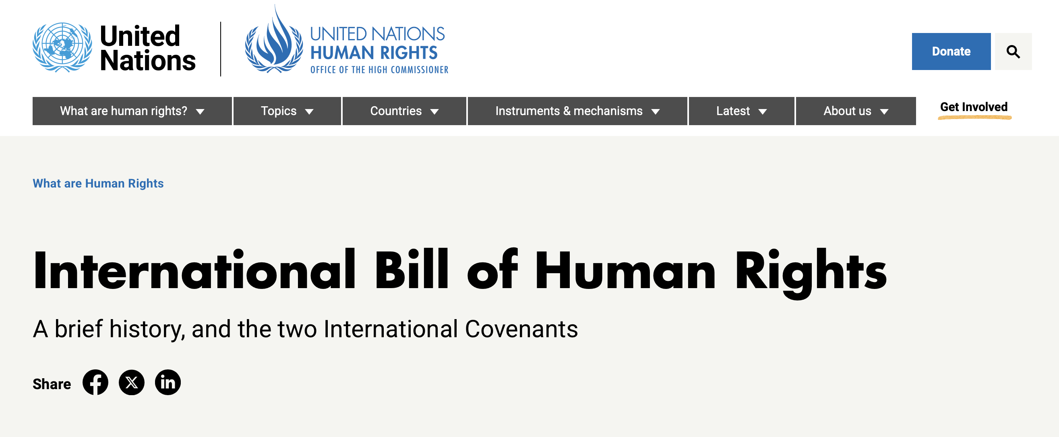
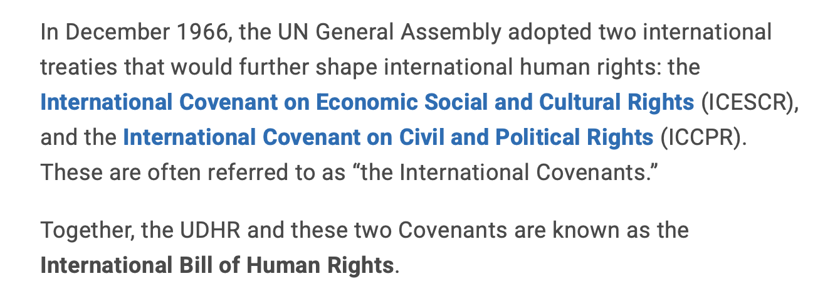

Slide 53
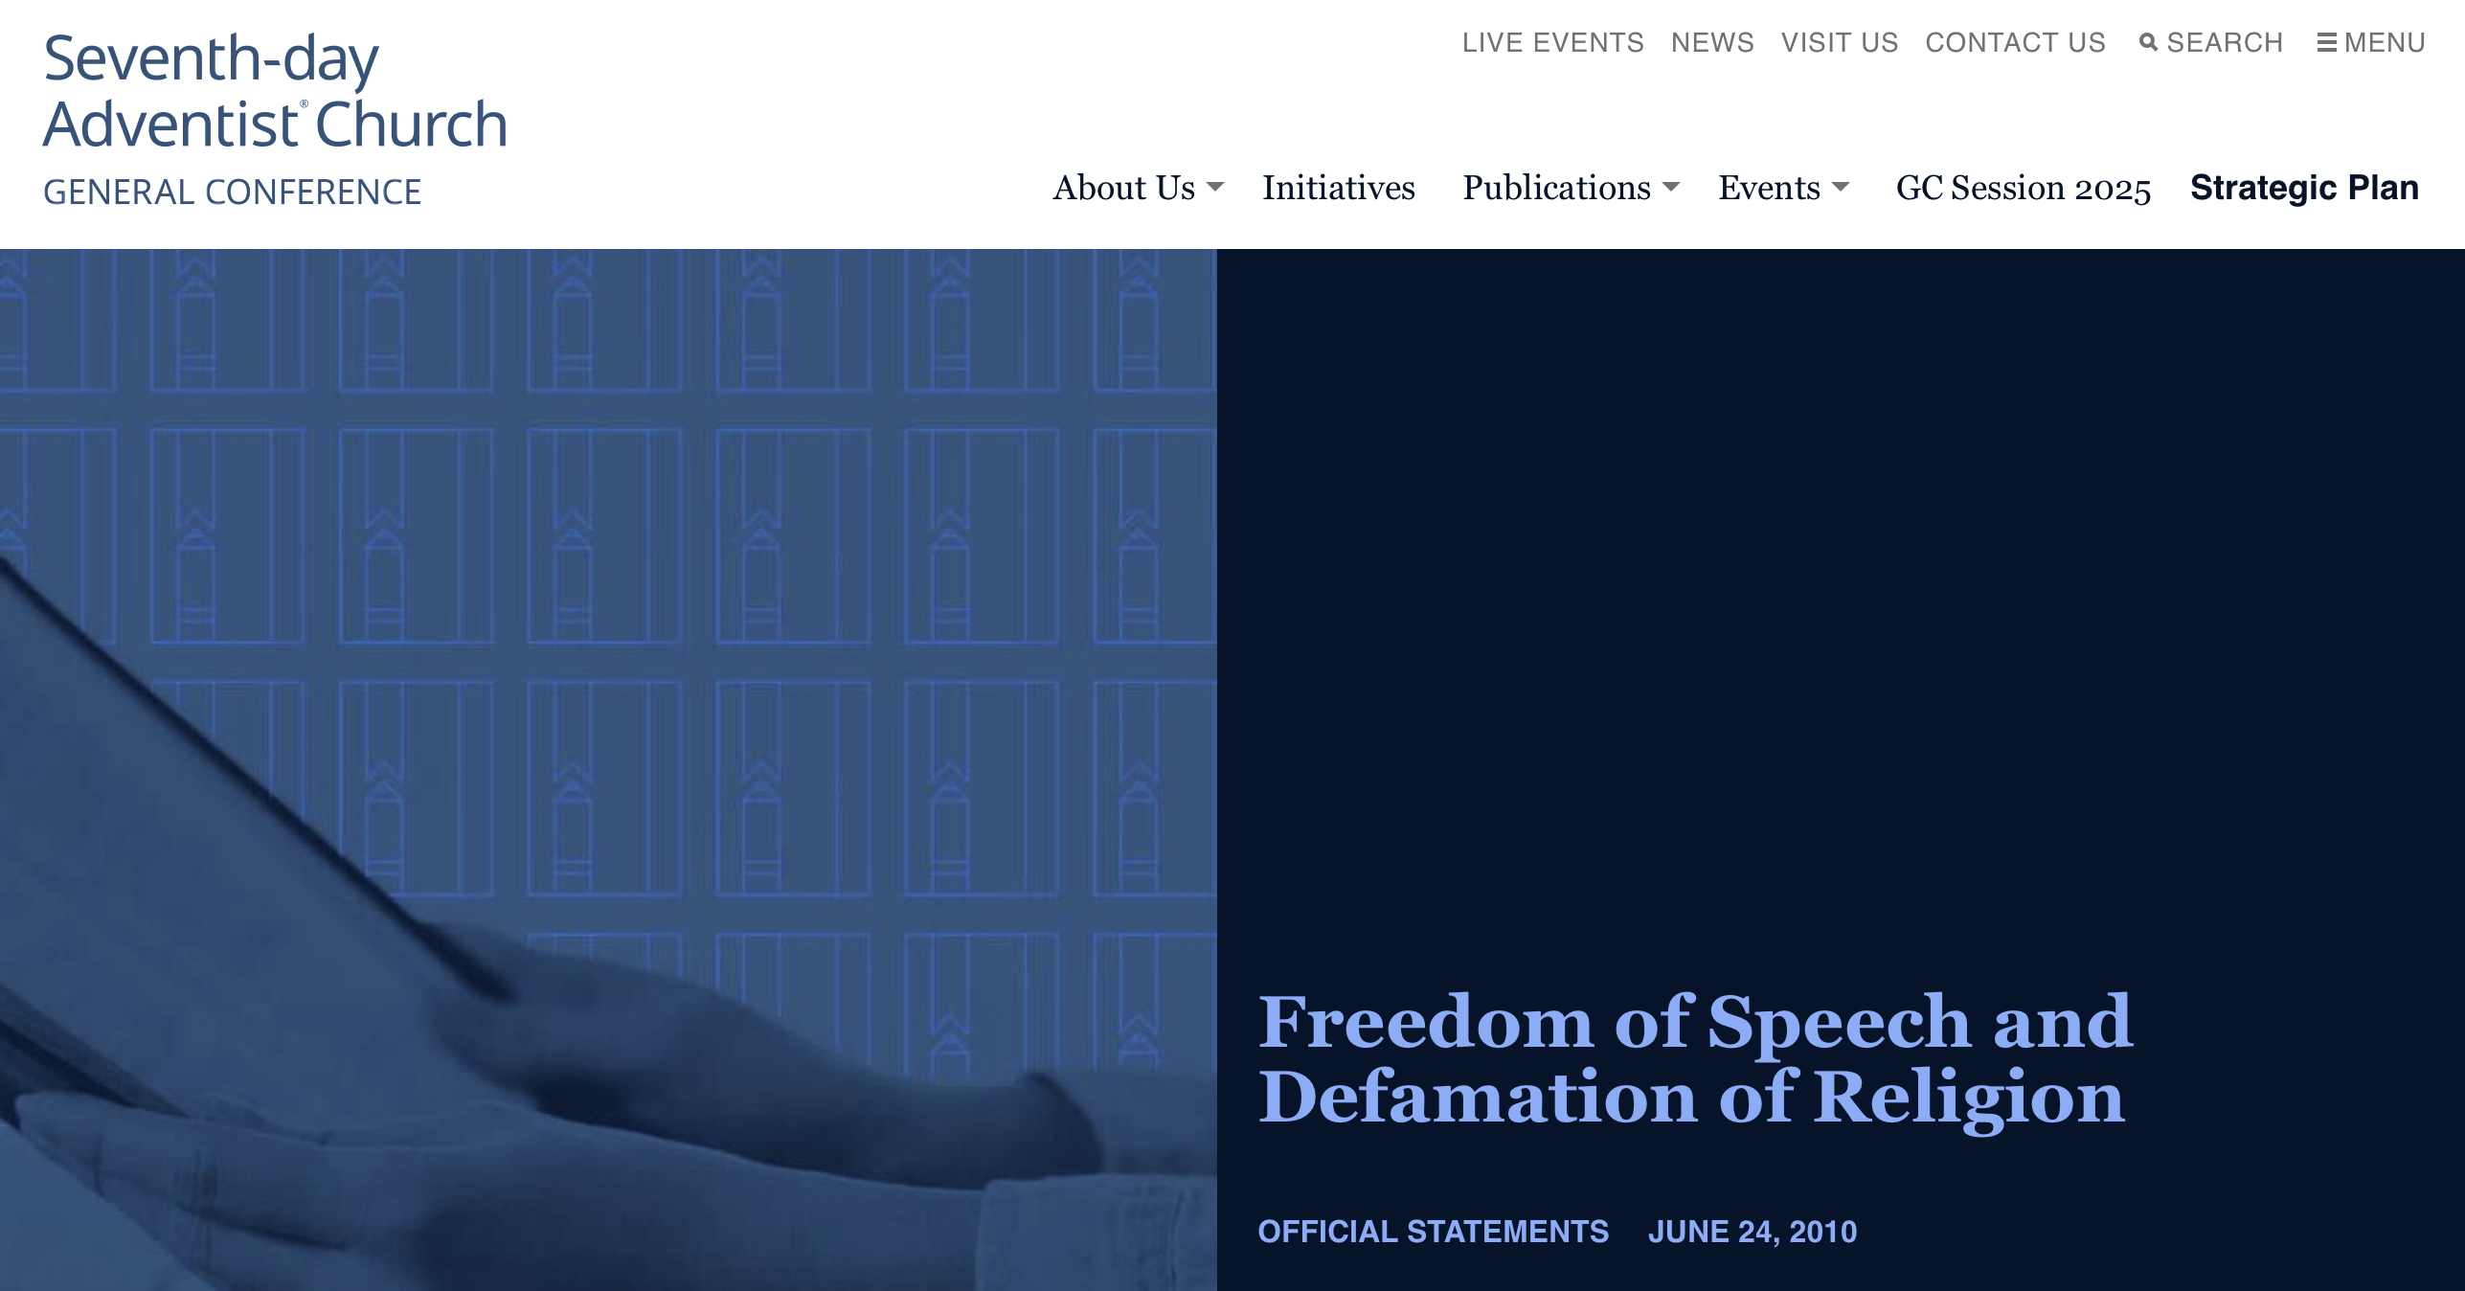
“The Seventh-day Adventist Church strongly supports freedom of speech in general, and freedom of religious speech in particular. Although freedom of speech is guaranteed in Article 19 of the Universal Declaration of Human Rights, efforts continue to limit speech at both the national level and at the United Nations.

Slide 54
…Our opposition to the restriction of speech is not without exceptions. The Church recognizes that in limited circumstances, speech can result in significant, tangible harm to the right to physical safety, the enjoyment of one’s property and other similarly compelling rights. In such very limited instances, we recognize the responsibility of the state to act to protect its population. When such limits are necessary, the Church expects governments to target restrictions narrowly to address only the dangerous speech in question.”

Slide 55
Prophets and Kings, p. 55
“The conscientious, considerate spirit that had marked his dealings with the people during the early part of his reign, was now changed. From the wisest and most merciful of rulers, he degenerated into a tyrant. Once the compassionate, God-fearing guardian of the people, he became oppressive and despotic. Tax after tax was levied upon the people, that means might be forthcoming to support the luxurious court.”

Slide 56
Prophets and Kings, p. 56
“Solomon had disregarded the instruction that God had given to serve as a barrier against apostasy, and now he gave himself up to the worship of the false gods. “It came to pass, when Solomon was old, that his wives turned away his heart after other gods: and his heart was not perfect with the Lord his God, as was the heart of David his father. For Solomon went after Ashtoreth the goddess of the Zidonians, and after Milcom the abomination of the Ammonites.” 1 Kings 11:4, 5.

Slide 57
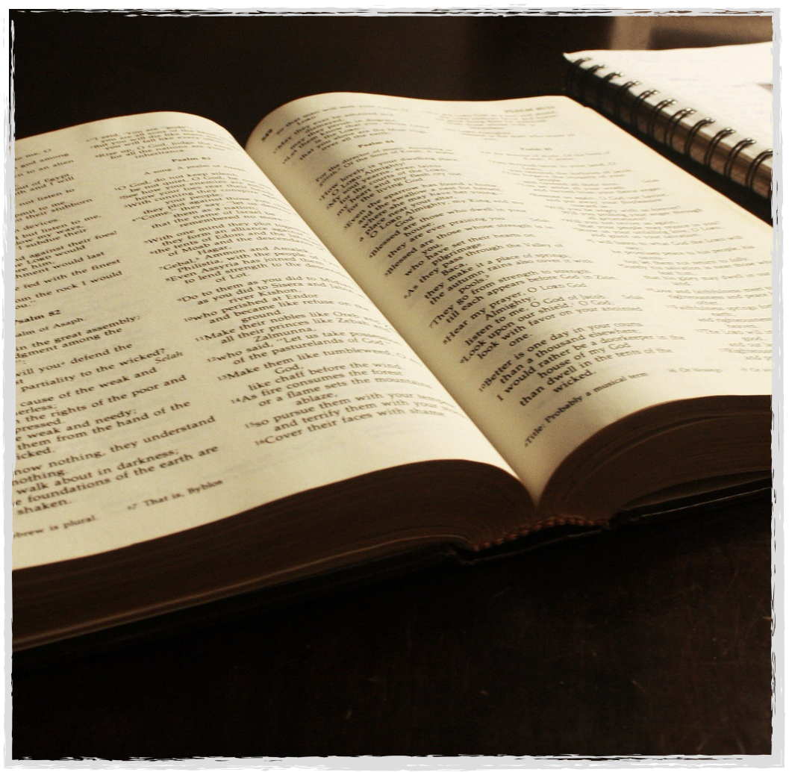
2 Corinthians 6:14, 17, 18
“Be ye not unequally yoked together with unbelievers: for what fellowship hath righteousness with unrighteousness? and what communion hath light with darkness?

Slide 58
2 Corinthians 6:14, 17, 18
Wherefore come out from among them, and be ye separate, saith the Lord, and touch not the unclean thing; and I will receive you,
And will be a Father unto you, and ye shall be my sons and daughters, saith the Lord Almighty.”
Notes:
Church not Babylon. Field trip. Babylon’s bedroom.

Slide 59
The Image of the Beast and the Great Test

